Slide 1
Probability and Distributions:
>Construction of a Probability Space, Discrete and Continuous Probabilities.
NAME: SARDA
REGISTRATION NO: 202237502

Slide 2
Construction of a Probability Space
The theory of probability aims at defining a mathematical structure to describe random outcomes of experiments. For example, when tossing a single coin, we cannot determine the outcome, but by doing a large num- ber of coin tosses, we can observe a regularity in the average outcome.

Slide 3
In the calculation, we equated two different concepts, the probability of the output of X and the probability of the samples in Ω. For example, in (6.7) we say P(X = 0) = P((£,£)). Consider the random variable X : Ω → T and a subset S ⊆ T (for example, a single element of T , such as the outcome that one head is obtained when tossing two coins). Let X−1(S) be the pre-image of S by X, i.e., the set of elements of Ω that map to S under X; {ω ∈ Ω : X(ω) ∈ S}. One way to understand the transformation of probability from events in Ω via the random variable X is to associate it with the probability of the pre-image of S (Jacod and Protter, 2004). For S ⊆ T , we have the notation
PX(S)=P(X∈S)=P(X^−1(S))=P({ω∈Ω:X(ω)∈S})

Slide 4
The left-hand side of is the probability of the set of possible outcomes (e.g., number of $ = 1) that we are interested in. Via the random variable X, which maps states to outcomes, we see in the right-hand side of that this is the probability of the set of states (in Ω) that have the property (e.g., $£, £$). We say that a random variable X is distributed according to a particular probability distribution PX , which defines the probability mapping between the event and the probability of the outcome of the random variable. In other words, the function PX or equivalently P ◦X^-1 is the law or distribution of random variable X. law
Remark. The target space, that is, the range T of the random variable X, is used to indicate the kind of probability space, i.e., a T random variable. When T is finite or countably infinite, this is called a discrete random variable (Section 6.2.1). For continuous random variables (Section 6.2.2), we only consider T =R orT =RD.

Slide 5
Discrete and Continuous Probabilities:)
Let us focus our attention on ways to describe the probability of an event as introduced in Section. Depending on whether the target space is discrete or continuous, the natural way to refer to distributions is different. When the target space T is discrete, we can specify the probability that a random variable X takes a particular value x ∈ T , denoted as P (X = x). The expression P (X = x) for a discrete random variable X is known as the probability mass function. When the target space T is continuous, e.g., the real line R, it is more natural to specify the probability that a random variable X is in an interval, denoted by P(a ≤ X ≤ b) for a < b. By convention, we specify the probability that a random variable X is less than a particular value x, denoted by P (X ≤ x). The expression P (X ≤ x) for a continuous random variable X is known as the cumulative distribution function. We will discuss continuous random variables in Section . We will revisit the nomenclature and contrast discrete and continuous random variables in Section .

Slide 6
Discrete Probabilities
When the target space is discrete, we can imagine the probability distribution of multiple random variables as filling out a (multidimensional) array of numbers. Figure shows an example. The target space of the joint probability is the Cartesian product of the target spaces of each of the random variables. We define the joint probability as the entry of both values jointly
P(X=xi,Y =yj)=nij/N
where nij is the number of events with state xi and yj and N the total number of events. The joint probability is the probability of the intersection of both events,thatis,P(X =xi,Y =yj)=P(X =xi ∩Y =yj). Figure illustrates the probability mass function (pmf) of a discrete prob- ability distribution. For two random variables X and Y , the probability

Slide 7

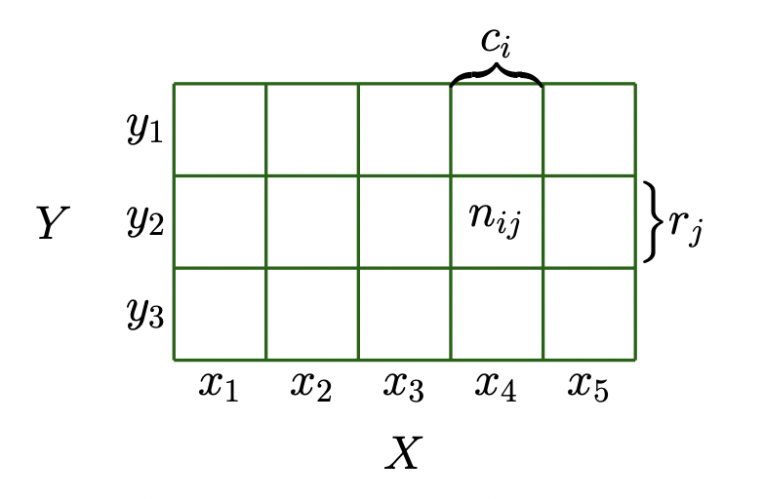
that X = x and Y = y is (lazily) written as p(x, y) and is called the joint probability. One can think of a probability as a function that takes state x and y and returns a real number, which is the reason we write p(x ,y). The marginal probability that X takes the value x irrespective of the value of random variable Y is (lazily) written as p(x). We write X ∼ p(x) to denote that the random variable X is distributed according to p(x). If we consider only the instances where X = x, then the fraction of instances (the conditional probability) for which Y = y is written (lazily) as p(y | x).

Slide 8
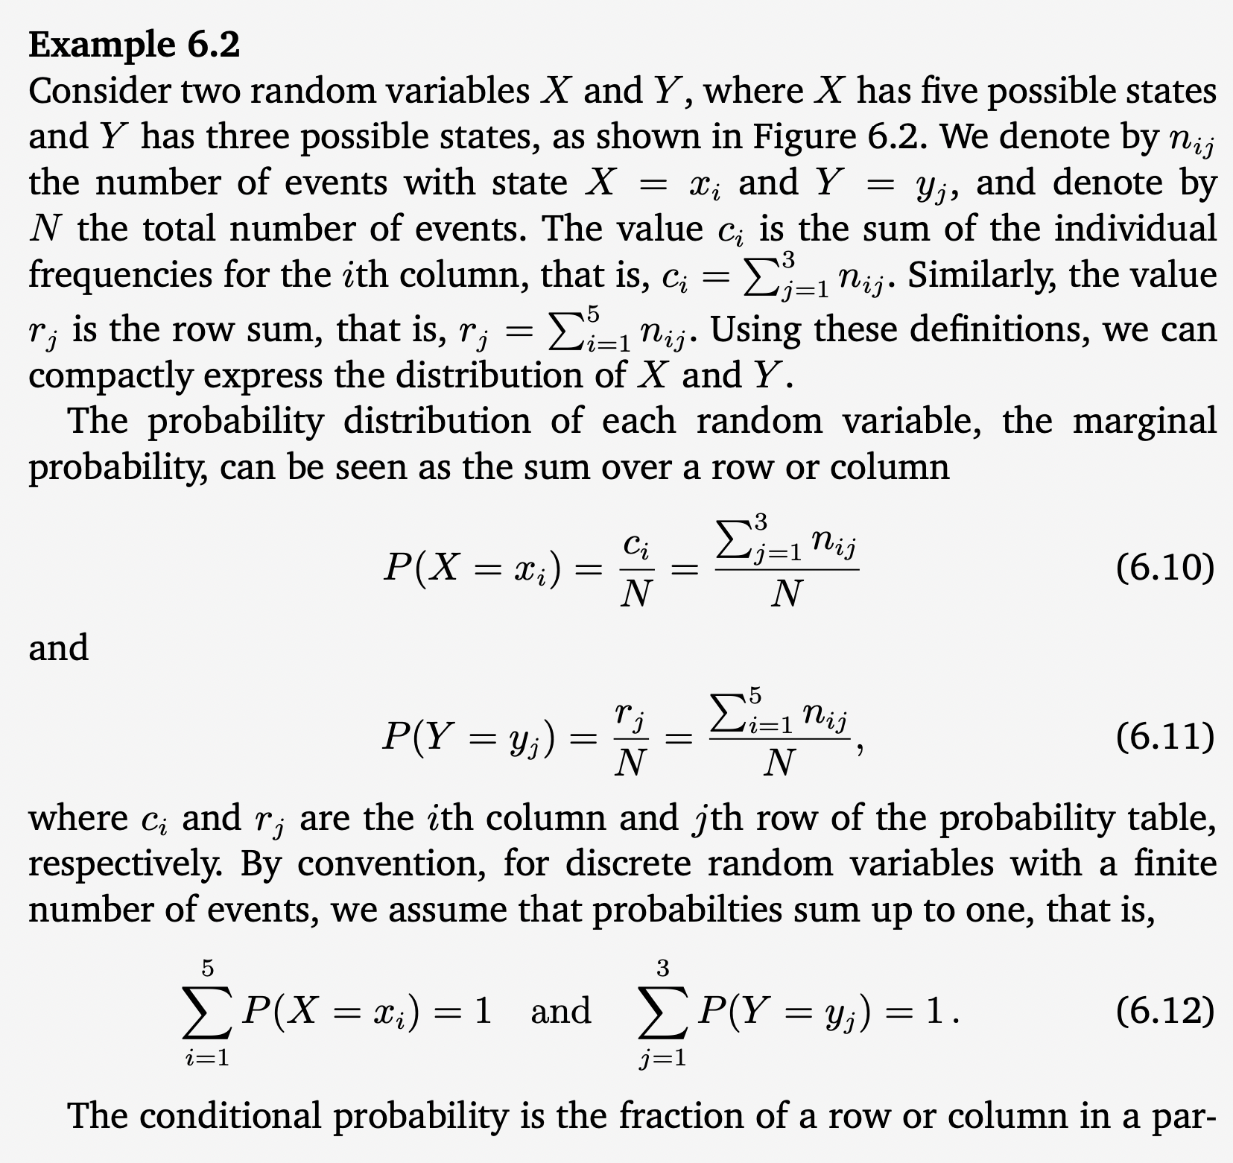
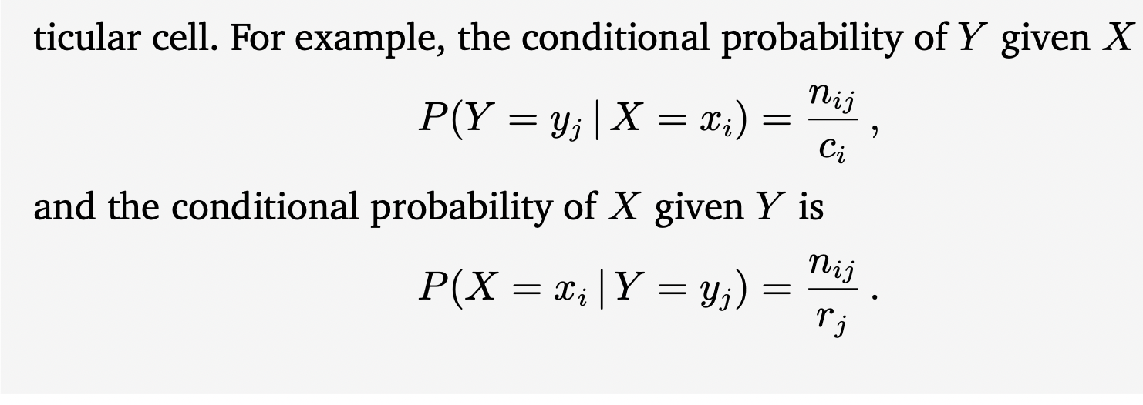

Slide 9
Continuous Probabilities
We consider real-valued random variables in this section, i.e., we consider target spaces that are intervals of the real line R. In this book, we pretend that we can perform operations on real random variables as if we have discrete probability spaces with finite states. However, this simplification is not precise for two situations: when we repeat something infinitely often, and when we want to draw a point from an interval. The first situation arises when we discuss generalisation errors in machine learning. The second situation arises when we want to discuss continuous distributions, such as the Gaussian. For our purposes, the lack of precision allows for a briefer introduction to probability.
Remark. In continuous spaces, there are two additional technicalities, which are counterintuitive. First, the set of all subsets (used to define the event space A is not well behaved enough. A needs to be restricted to behave well under set complements, set intersections, and set unions. Second, the size of a set (which in discrete spaces can be obtained by counting the elements) turns out to be tricky. The size of a set is called its measure. For example, the cardinality of discrete sets, the length of an interval in R, and the volume of a region in Rd are all measures.

Slide 10

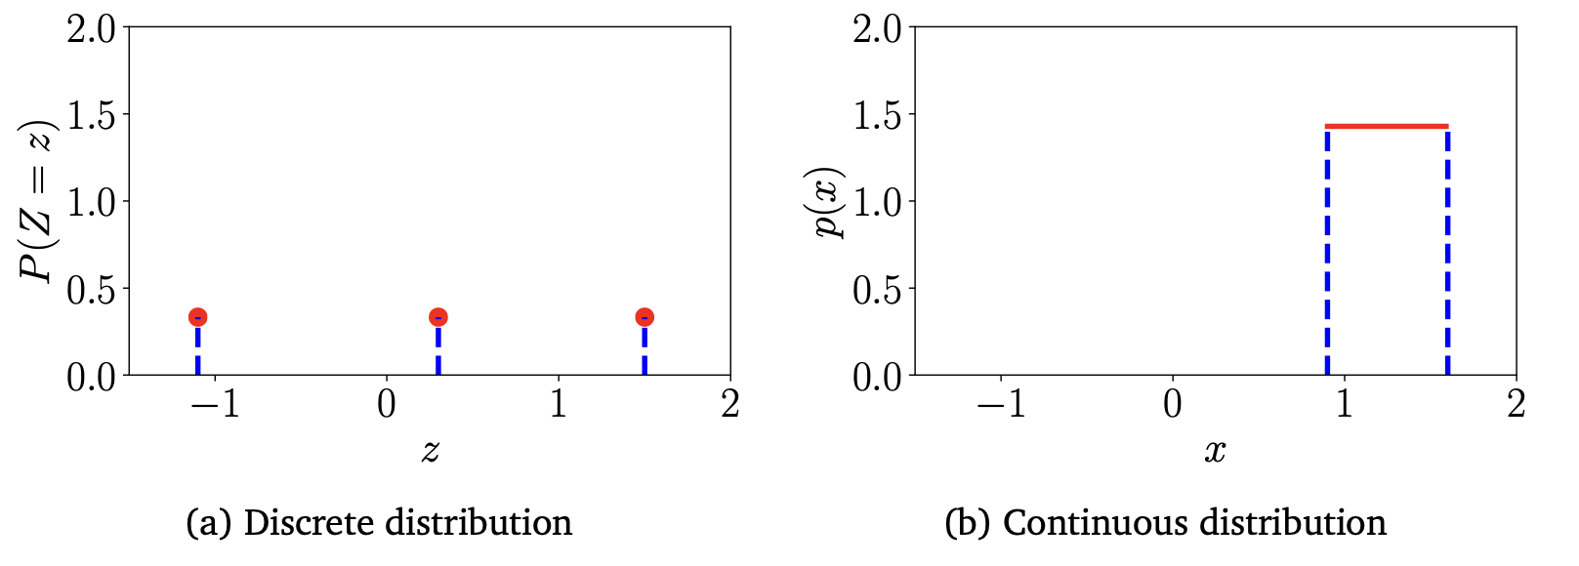
Figure 6.3 Examples of (a) discrete and (b) continuous uniform distributions. See Example for details of the distributions.
For most of this , we will not use the notation f (x) and FX (x) as we mostly do not need to distinguish between the pdf and cdf. However, we will need to be careful about pdfs and cdfs in Section 6.7.

Slide 11
Contrasting Discrete and Continuous Distributions
Recall from Section that probabilities are positive and the total prob- ability sums up to one. For discrete random variables, this implies that the probability of each state must lie in the interval [0,1]. However, for continuous random variables the normalization does not imply that the value of the density is less than or equal to 1 for all values. We illustrate this in Figure using the uniform distribution for both discrete and continuous random variables.
The actual values of these states are not meaningful here, and we deliberately chose numbers to drive home the point that we do not want to use (and should ignore) the ordering of the states.

Slide 12

Thank you:)

